Slide 1
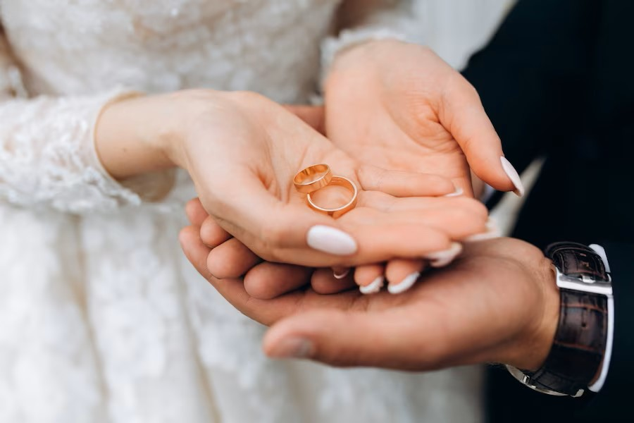
BUSINESS PLAN
Krishna Mishra
Batch:03

Slide 2


RP
RINGOPLE
BY: Krishna
OWNER: Krishna Mishra

Slide 3
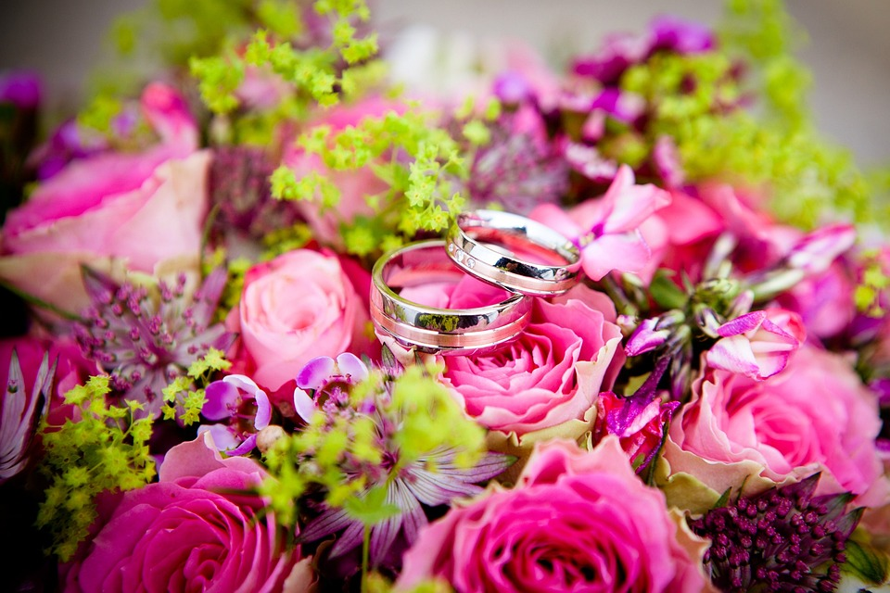

Ringople is a brand offering personalised couple rings made for their special occasions started by Krishna Mishra in the year 2019. The dream of her to start something by herself come out as a result of this. The brand offer all kinds of personal rings as per the choice of the customer and their needs. Ringople is located in pune(Deccan) itself and also have a branch in Banglore also .
ABOUT
US
RP

Slide 4
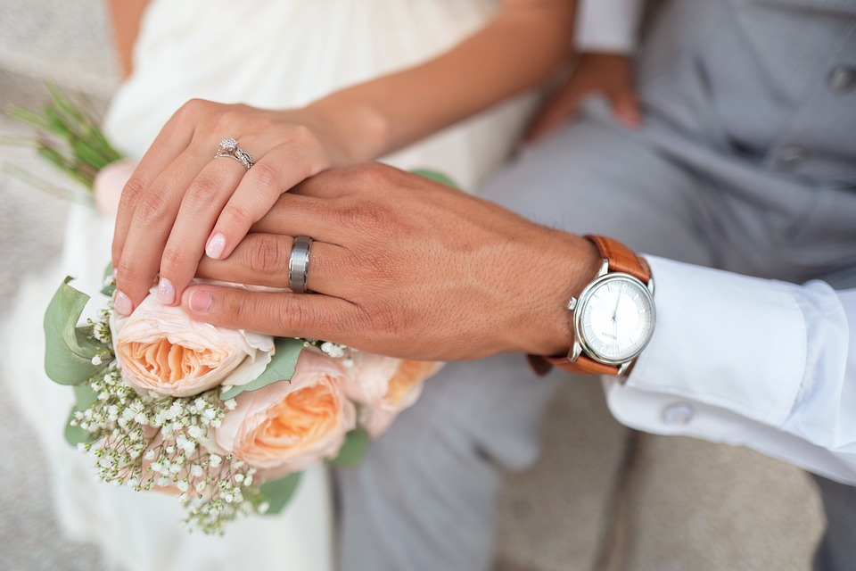

Our main aim is to become the most famous in store for the personalised rings in all ober Pune and other cities too. We are also tying to make our association by Tanishq in the recent 5 years which is 2026. Our scope is too offer new and innovative designs to the couples who have always wanted to make a best memories from there main days in life.We are aiming to open a showroom soon in Pune.
OUR
VISION
RP

Slide 5
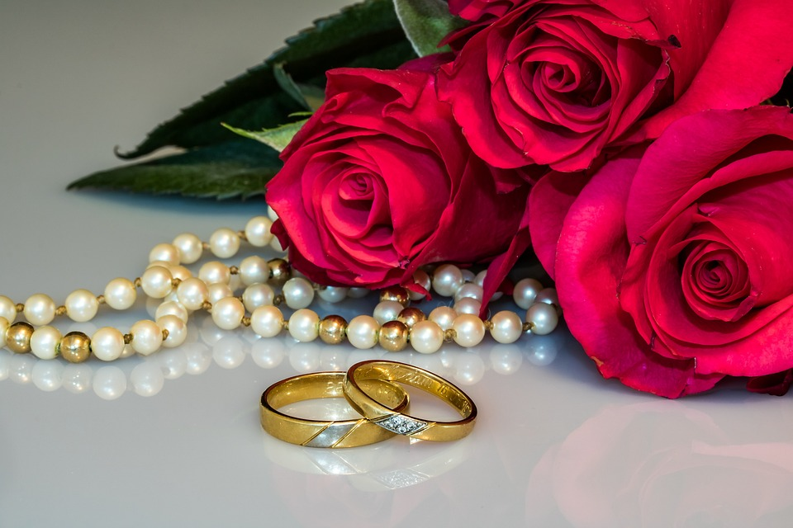
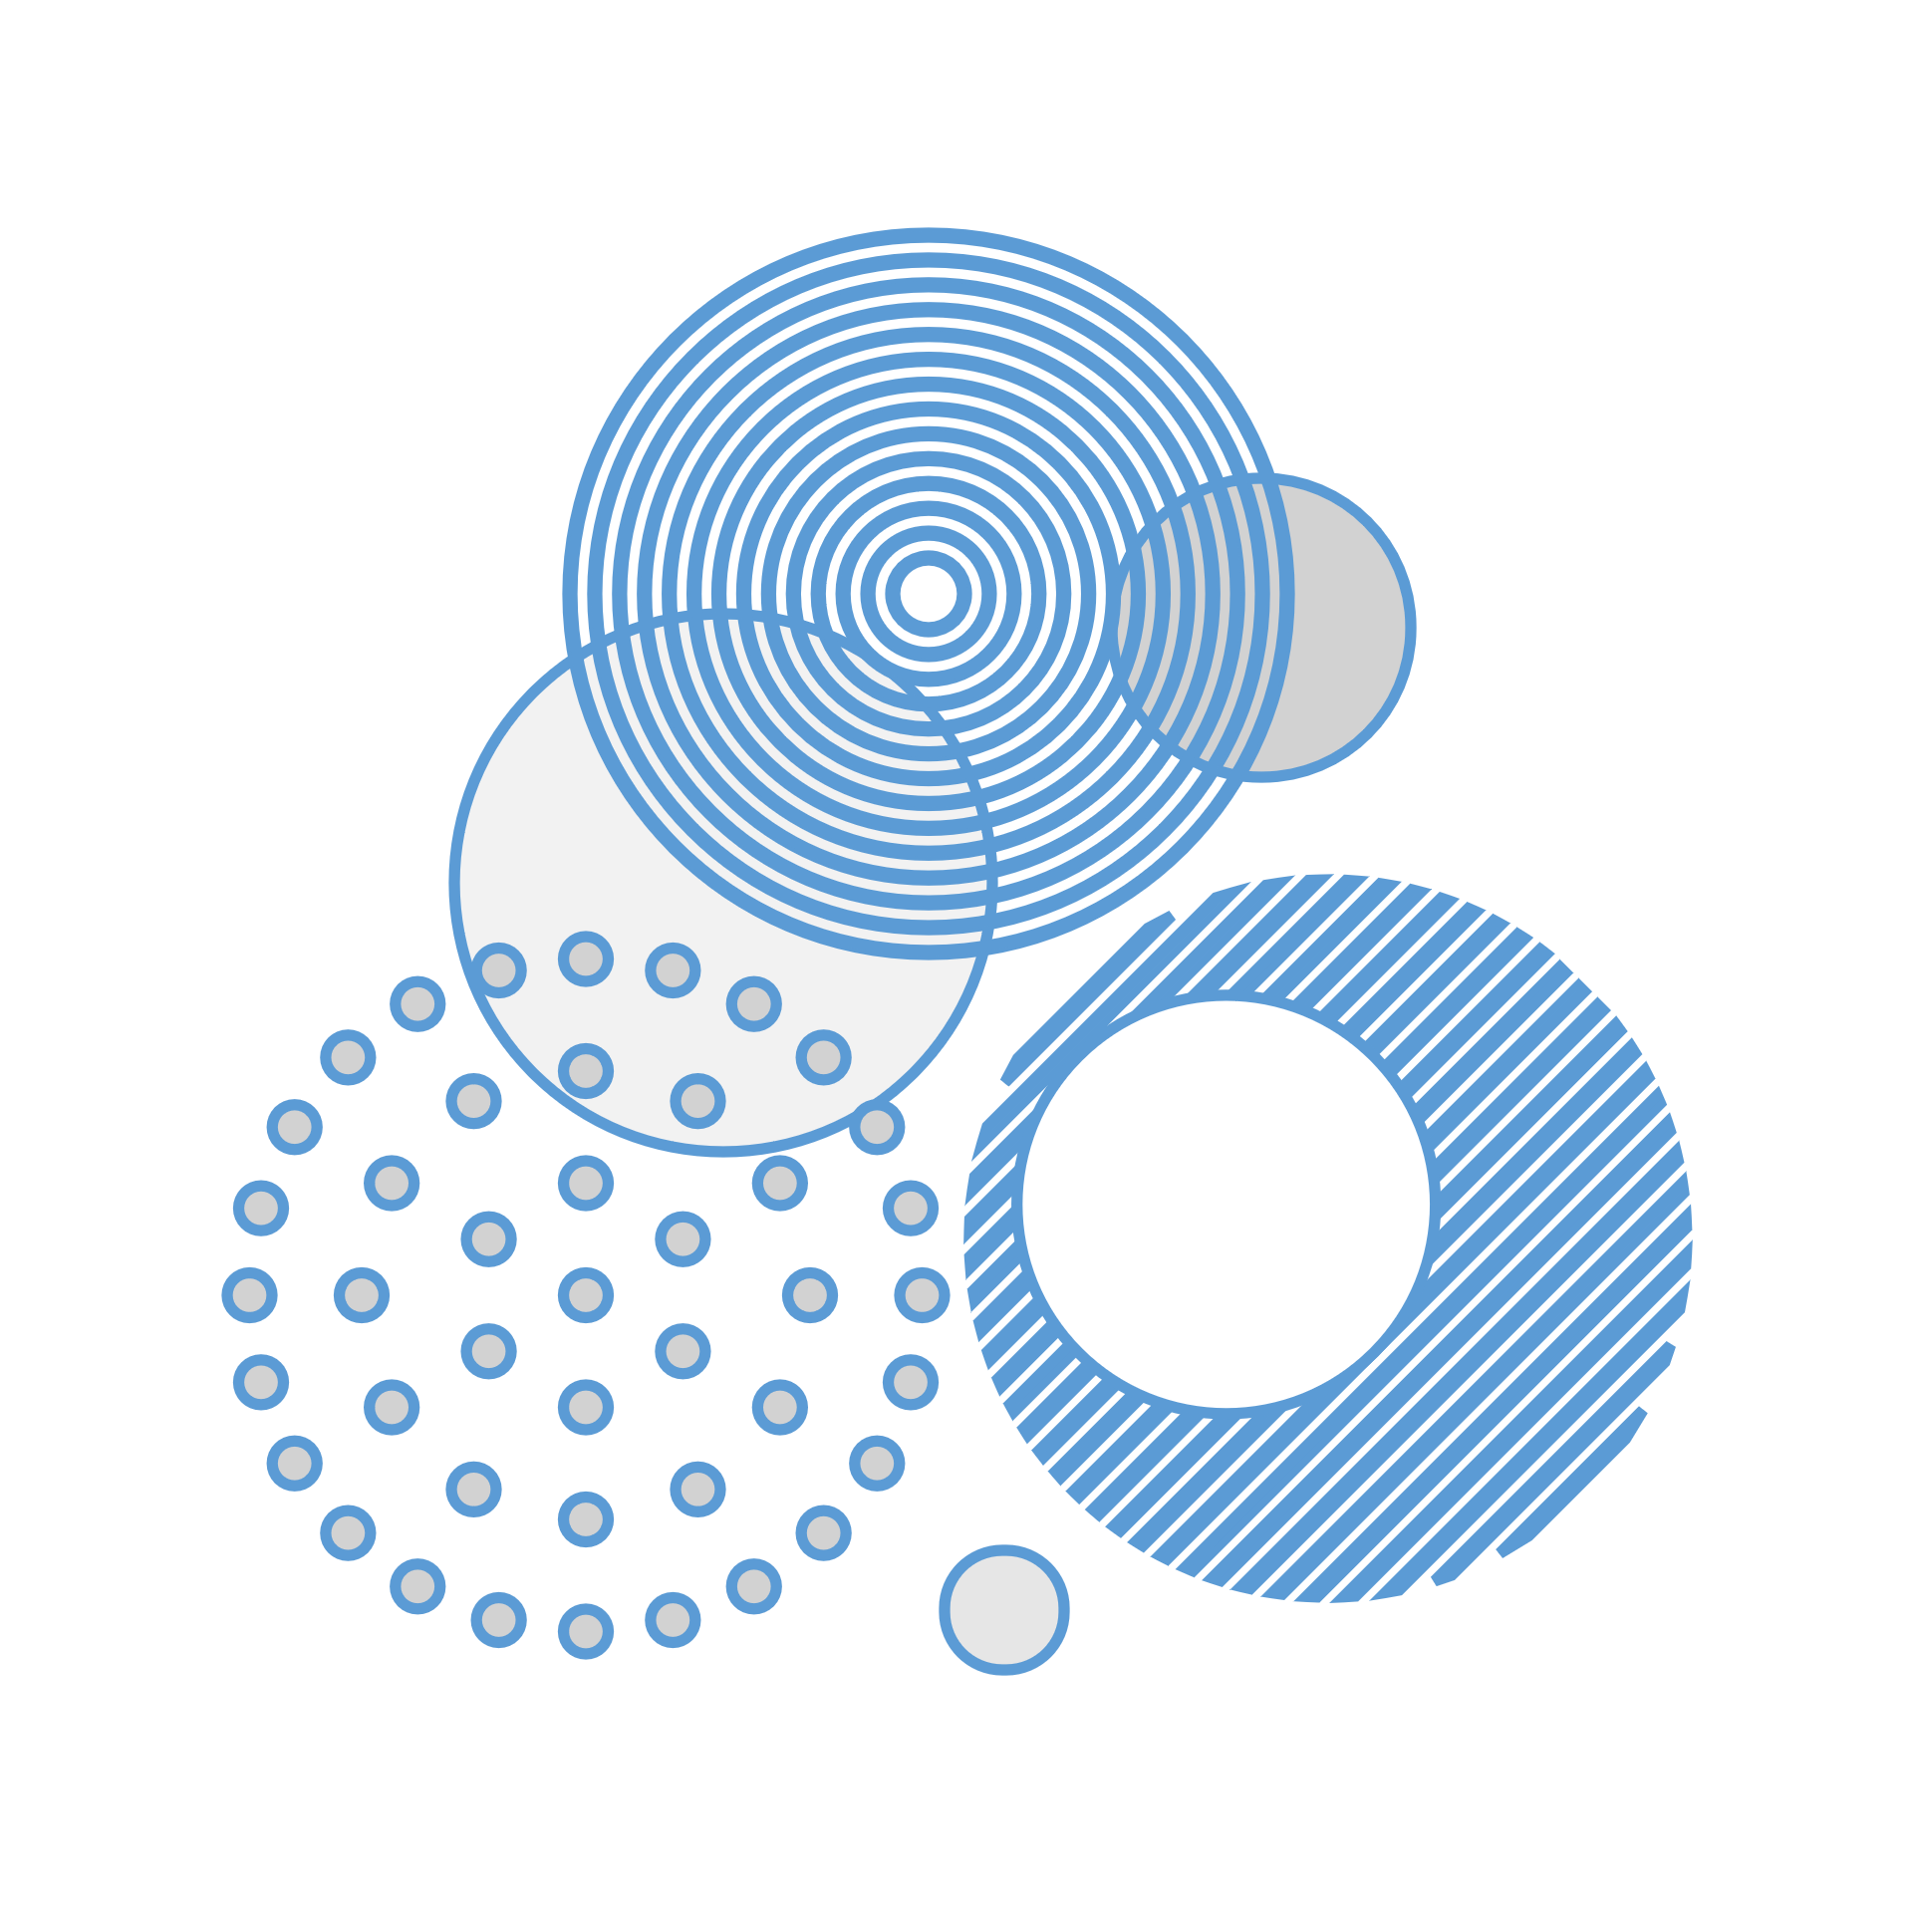
The mission is to serve the couple the best service with all the demands they made to us in every way possible . We also serve the amounts raised by this work to the orphans in the nearby areas and to give them a comfortable life with all happiness . The aim is to serve the love birds their own collections of happiness by bringing them to the most beautiful destination around them.
OUR
MISSION
RP

Slide 6
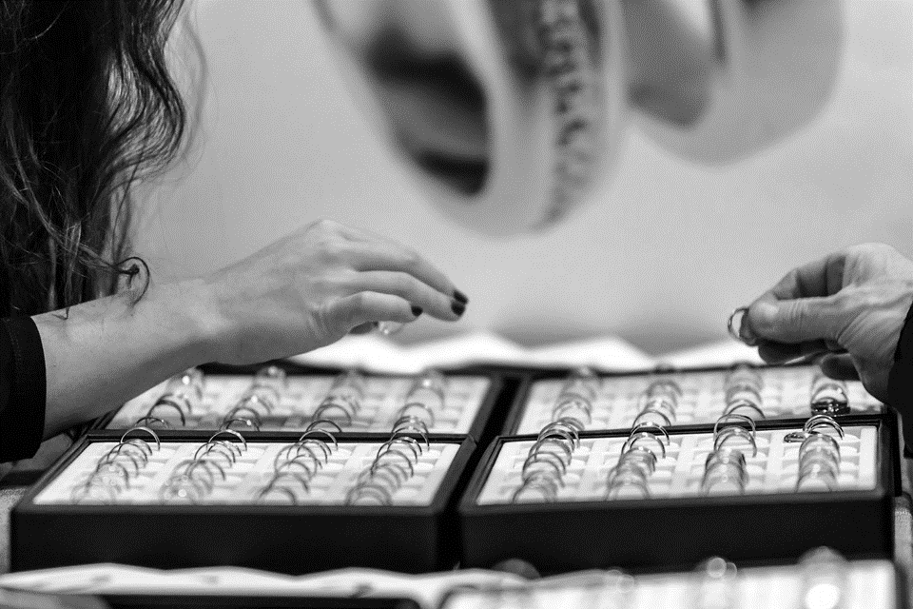
v
TARGET AUDIENCE
RP
AGE
GENDER
INCOME
RANGE
32-37
20-25
27-30
FEMALE
MALE
OTHER
50,000
40,000
25,000
v

Slide 7
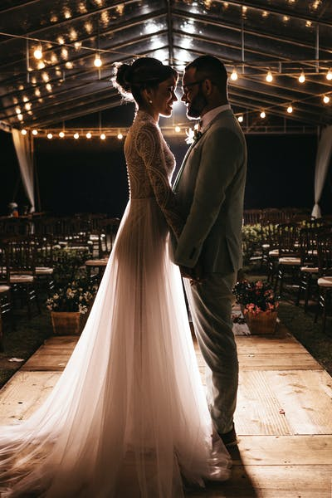

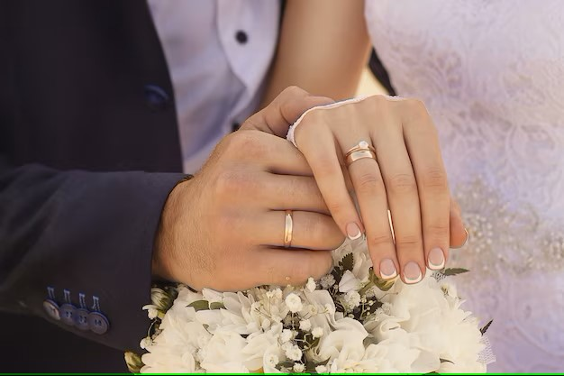
CUSTOMERS REVIEW
This is Rahul and Devika from Pune itself. We would love to thanks Ringople for such a beautiful and precious rings which were atmost affordable for us to have a choice to go with it. We would also love to make a good contact with them in future for any such special occasssion.
RP

Slide 8
COMPETITOR ANALYSIS
RP
S.No | Competitor Name | Brand Name | Product Range | Product Pricing | Other Description
1. | Vikas Gutgutia | FERNS AND PETALS | Couple braclets, Photoic rings, Couple rings | Rs:5000-6000 | Special offers per week,50%off on combo,Online sell.
2. | Sujeet Kumar Mishra | WINNI | Parents specialised rings, Statement rings. | Rs:3000-8000 | Free gift voucher a month,Website, Quality products.
3. | Vivek Krishna | AUGRAV | Forever hidden message gold ring,Platinum bands. | Rs:4500-6000 | But 2 get 1free, Online sell,Quality products.

Slide 9
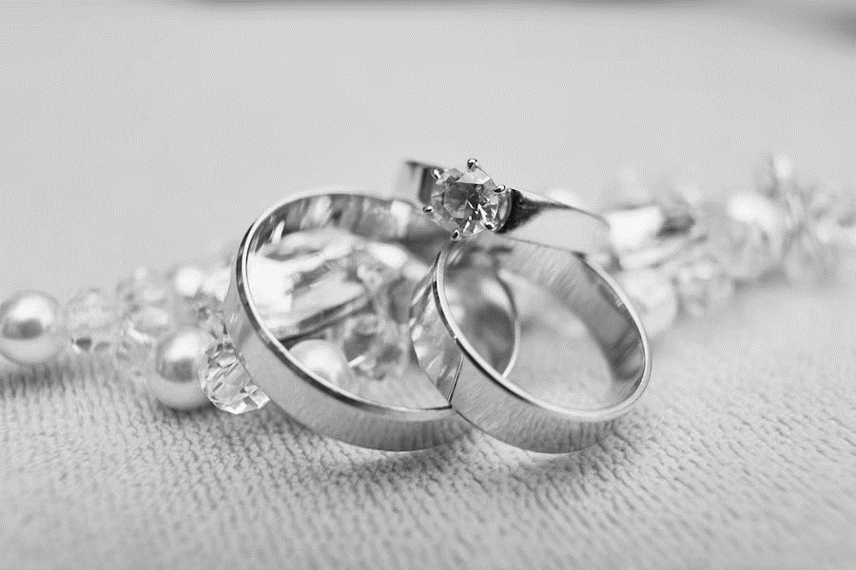
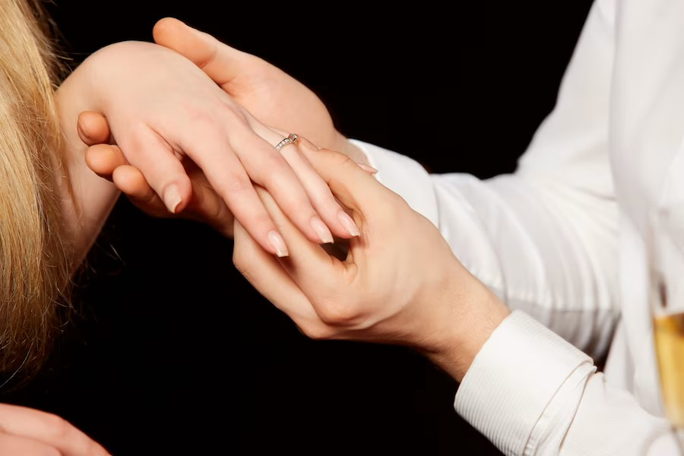
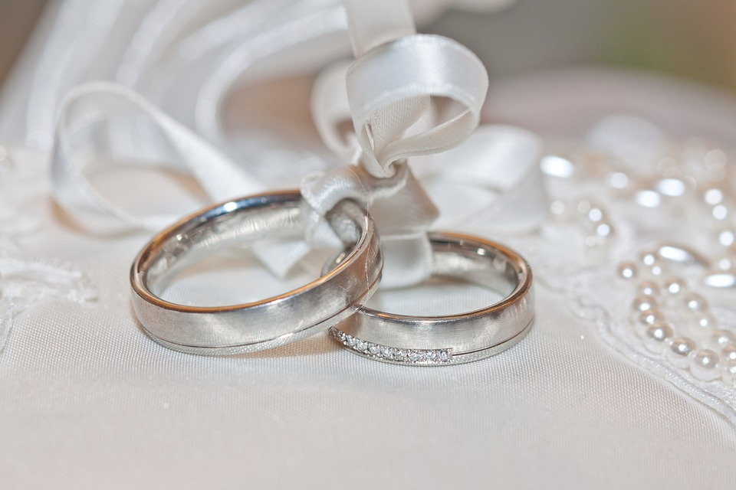
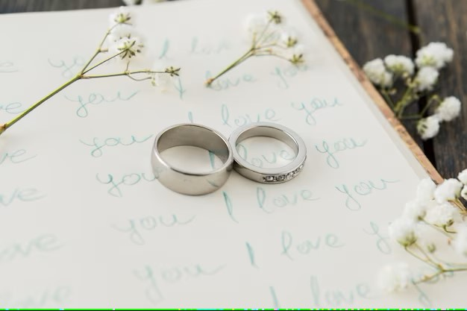
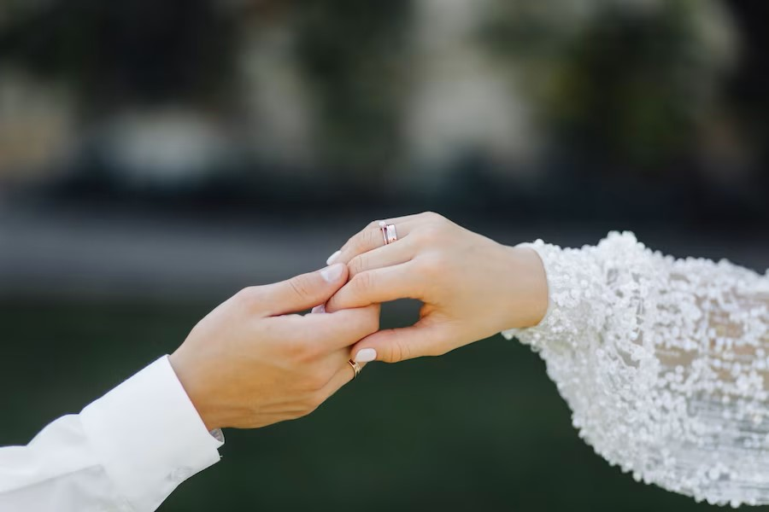
SILVER RING
The silver ring contains personalized photos and names on the rings which is easy to remove and can be changed by time according to the customers opinion. High quality assurance given to it and the ring can be esilty adjustable.
RP

Slide 10
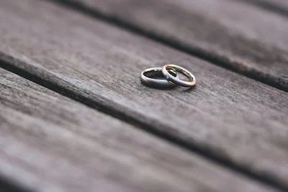
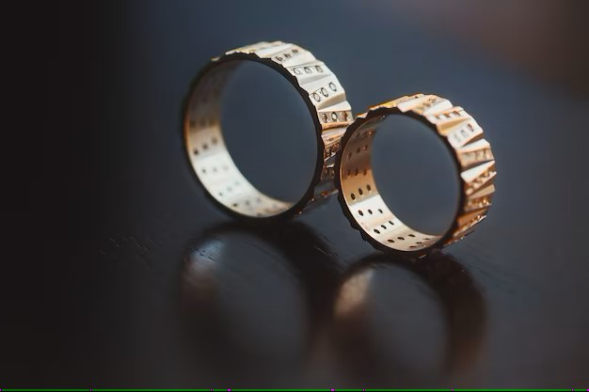
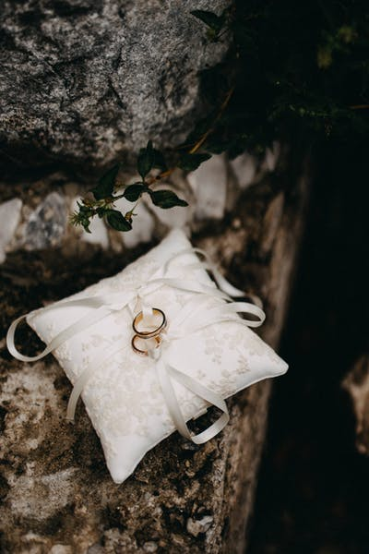
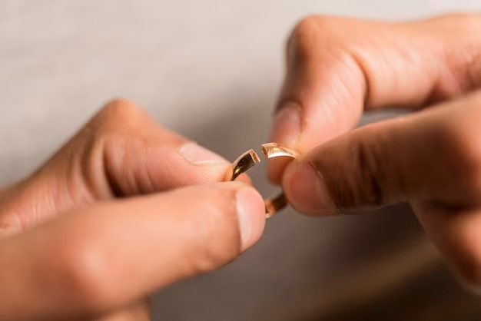
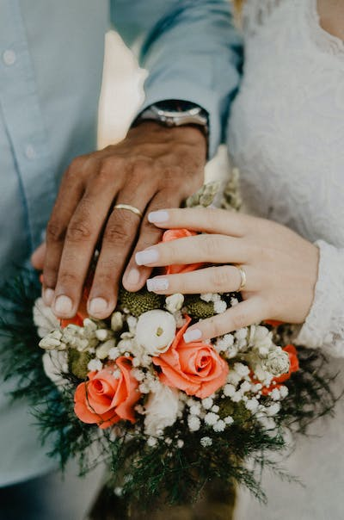

PLATINUM RING
RP
Our Platinum ring is made up of the real quality stones and have a fine details to it and it shows personalized designs. The ring can be transformed into one single bracelet which fits exactly the hands of the customers which is unisex .

Slide 11

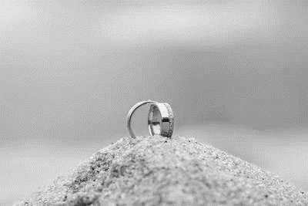
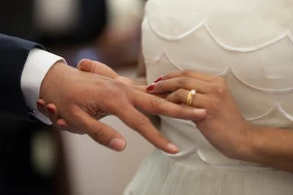
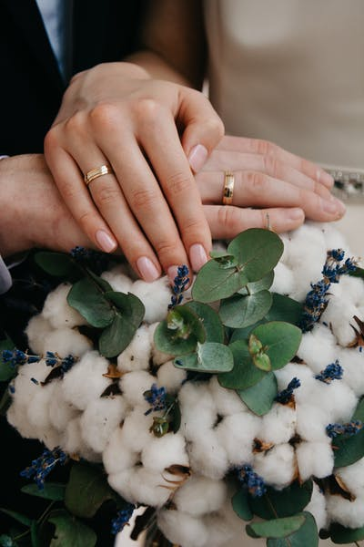
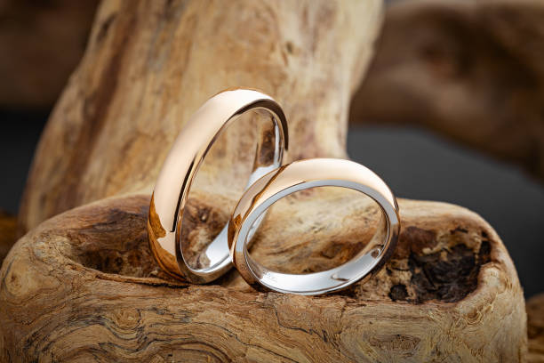
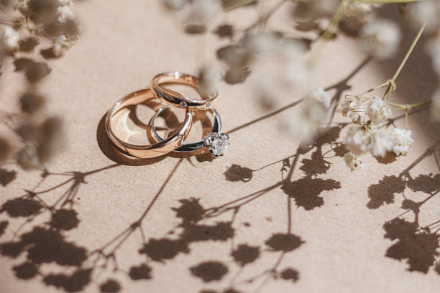
ROSE GOLD RING
The ring is made up of pure real carat gold and gave high quality finishing to it. There is fine detailing to the design of te shapes. We offer the color gurantee for more than 6 years to the ring. The ring can be converted into two separate earings.
RP

Slide 12



PRODUCT PRICING
RP
Product Name | Cost
Platinum Ring | 6550
Silver Ring | 4250
Rose Gold Ring | 5050

Slide 13
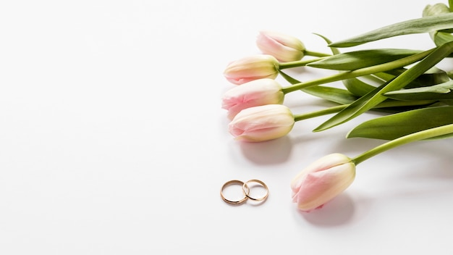
BUSINESS STARTUP COST
One time cost/Fixed cost | Amount | Amount | Recurring cost/monthly cost | Amount | Amount
Tool/Machinery | 185600 | 185600 | Place(rented) | 4,50,000 | 4,50,000
Marketing | 36575 | 36575 | Product development | 3478500 | 3478500
 |  |  | Stationery | 2390 | 2390
 |  |  | Packaging | 675 | 675
 |  |  | Legal Formalities | 6499 | 6499
Total | 222175 | 222175 | Total | 39,38,064 | 39,38,064
 |  |  | Total Actual Cost | 41,60,239 | 41,60,239
FUNDING
Self |  |  |  | 660239
Loan |  |  |  | 2500000
Invester |  |  |  | 1000000
Total Funding |  |  |  | 4160239
RP
LINK: Business startup checklist

Slide 14
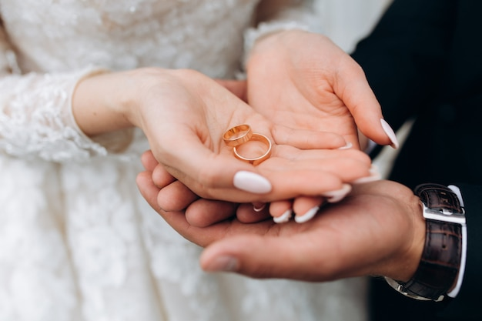

MARKETING AND BRANDING
The brand Ringople is meant for the young couples age group between 21-36, the marketing channel that we would be using will be all kinds of paper prints like the advertisement, magazines as more people get the adds of marriage in paper and magazines is also in demand now a days for the ongoing generations and the final path will be the social meadia which includes Instagram, Facebook, Tinder because the young generations prefer to get everything online and hence the best platform or them to have such beautiful rings will be the online one. We will be creating a website which will be available all the time so that there will be no interruption between the customers and the company.
RP

Slide 15

STRENGTH
Good quality
Good location
Best service
RP
Less staff
Less collection
Poor tecnology
WEAKNESS
Good income
Good marketing
Highest valuation
OPPORTUNITIES
Great competitor
Seasonal market
Illegal marketing
THREATS

Slide 16
THANK YOU!

